Slide 1
Disclaimer
This training resource was developed to be used with the CZ ID platform
In October, 2026, stewardship of CZ ID transitioned to UCSF and the platform was renamed to SeqtoID
These training materials are not being actively maintained and may not reflect differences between CZ ID and SeqtoID, subsequent changes to the platform, or current methods and best practices in metagenomic sequencing and analysis

Slide 2

Generating heatmaps using ONT data from CZ ID
Rapid Response – Updated Sept 2026
Notes:
Slides updated 07/02/2024

Slide 3
Web-app to create heatmaps
CZ ID does not have a heatmap visualization feature for the ONT pipeline
This web app is designed to mimic this functionality using sample taxon reports downloaded from CZID (Github link)
Notes:
https://github.com/gowtham-thakku/ont-heatmap
https://ont-heatmap.streamlit.app/

Slide 4
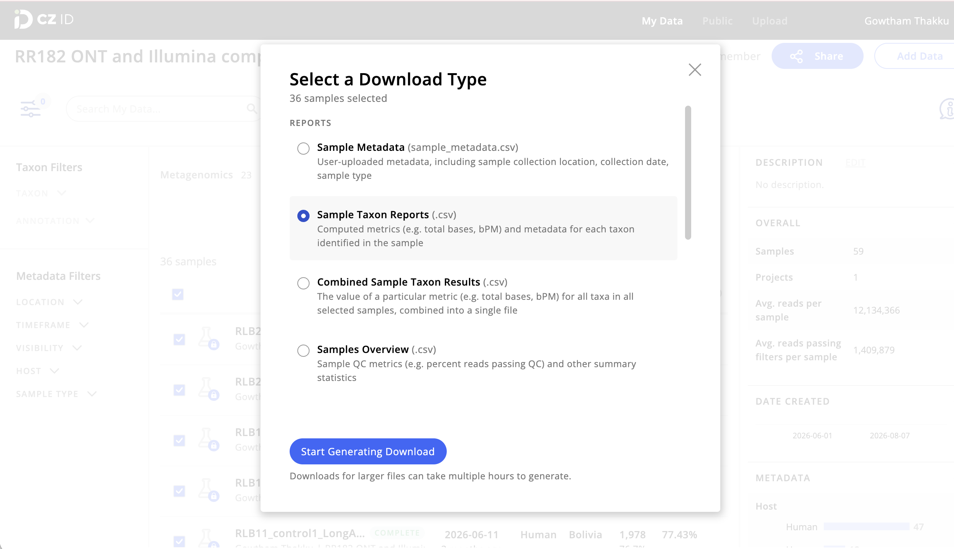
Step 1: Download sample taxon reports

Slide 5
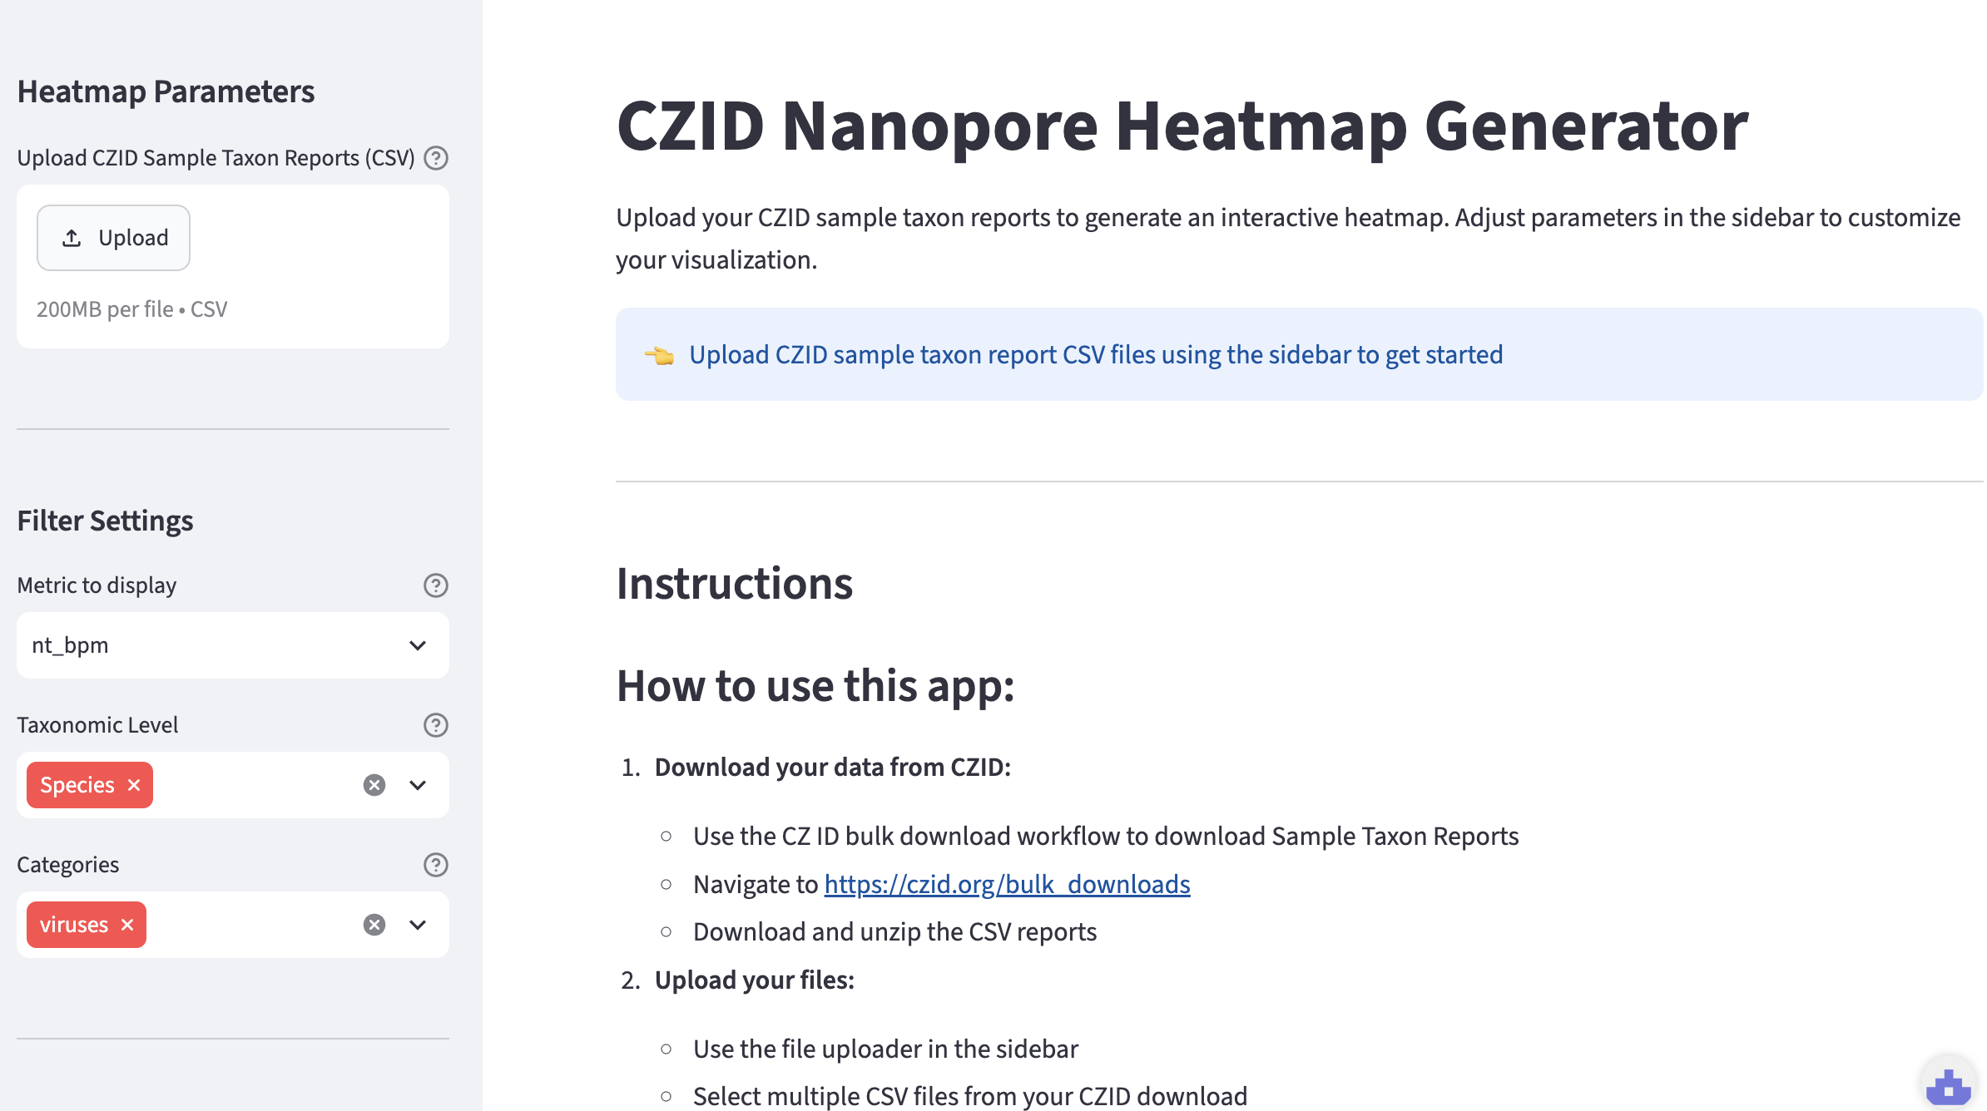
Step 2: Open the app and upload reports
Link to web app
Notes:
https://ont-heatmap.streamlit.app/

Slide 6
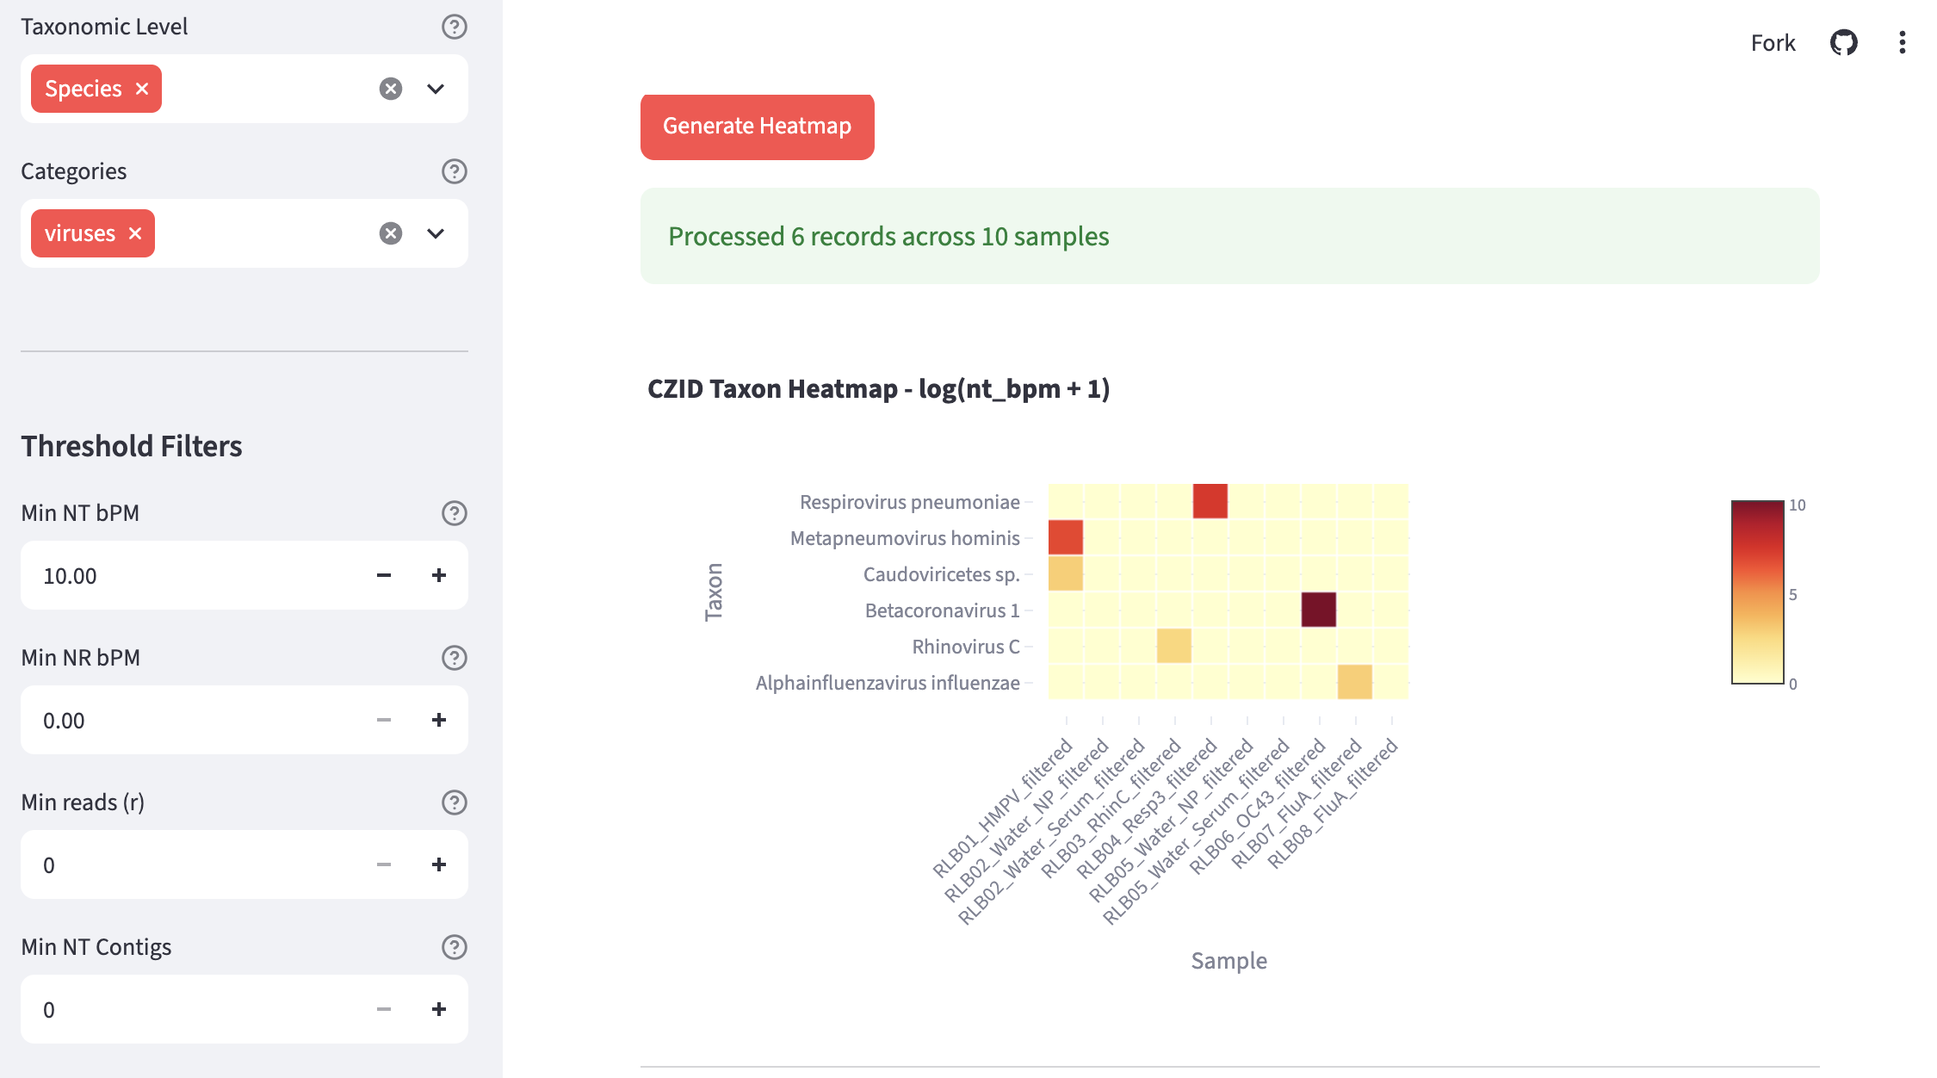
Heatmap shows abundance with threshold options on the left panel

Slide 7
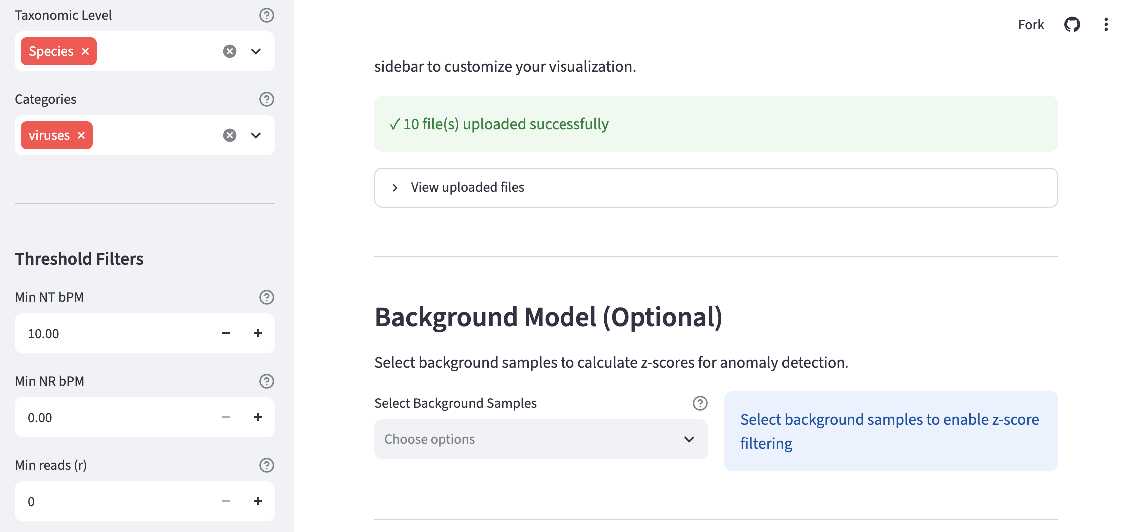
Optionally select samples to include in a background model
The background model uses the same Z-score calculation as the Standard model used in the CZ ID Illumina pipeline, except using bPM as the abundance metric instead of rPM

Slide 8
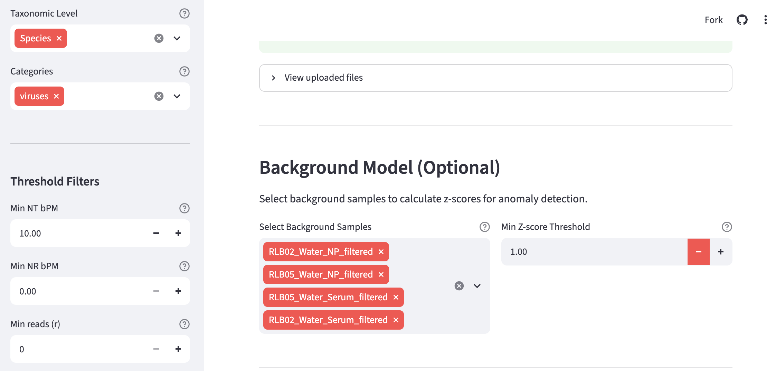
Set Z-score threshold for use in the background model
Choice of Z-score threshold depends on the levels of contamination observed, but a good starting point is a threshold of 1.00

Slide 9
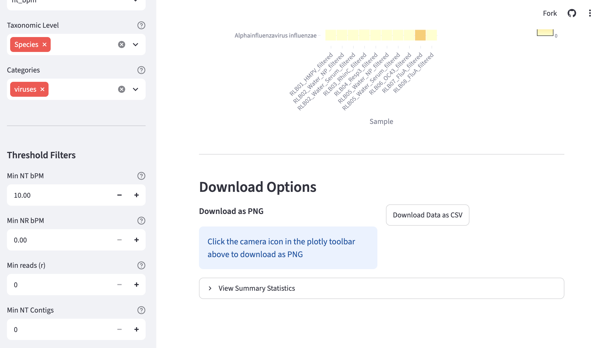
Heatmap can be download as .png image file or .csv data file

